Slide 1

Social Security:
With You Through Life’s Journey…
Produced at U.S. taxpayer expense
Notes:
DO NOT remove the taxpayer expense disclaimer from this slide, as it is now required by law.

Slide 2

Did You Know?
About 177 million workers will pay Social Security taxes in 2019.
About 94 percent of all workers are covered or eligible under Social Security.
Notes:
Did you know that about 177 million workers will pay Social Security taxes in 2019? About 94 percent of all workers are covered or eligible under Social Security.
Source for the first sentence is the 2018 Trustees Report intermediate assumptions, single year table IV.B3 (https://www.ssa.gov/OACT/TR/2018/lr4b3.html)
Source for the second sentence is OCACT estimates (unpublished)
Source: ^OCACT
Slide updated 2/5/2019

Slide 3
Social Security Beneficiaries
December 2018
Notes:
This image illustrates the number of beneficiaries we pay. Currently, more than one in every six people in America is receiving a Social Security benefit. The majority of our beneficiaries are retired.
But Social Security is more than retirement...it is a family protection plan (almost 1/3 of the beneficiaries are disabled, dependents of disabled, or survivors).
Social Security is an intergenerational transfer system: today’s workers help pay for current retirees’ and other beneficiaries’ benefits, not their own future benefits.
There’s no account set aside with your name and contributions on it.
Source: https://www.ssa.gov/policy/docs/quickfacts/stat_snapshot/index.html?qs (Table 1)
Source: ^Statistics
Slide updated 2/5/2019

Slide 4

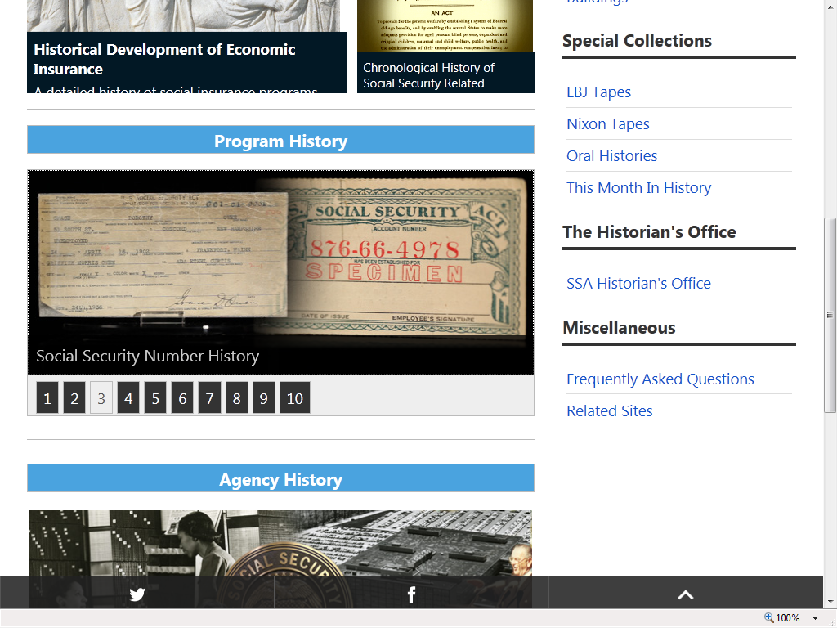
August 14, 1935
Social Security 83 Years –

Slide 5
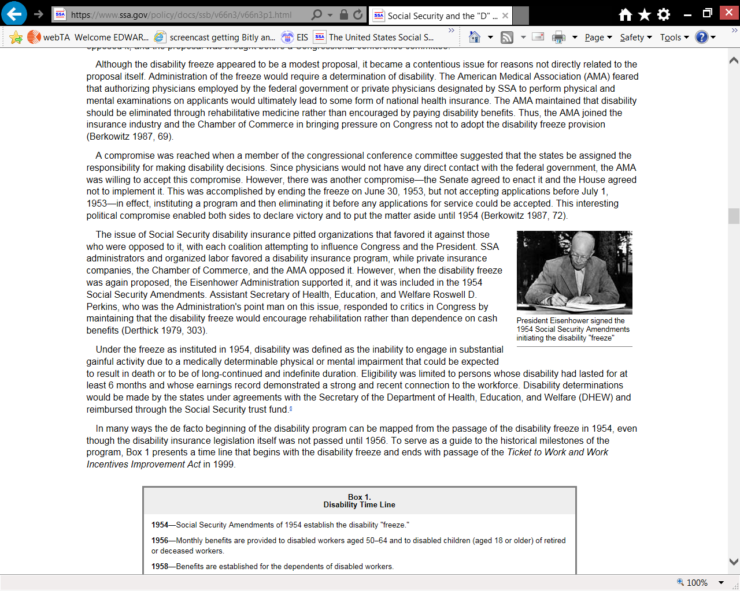
62+ Years of Social Security
Disability Insurance
August 1, 1956

Slide 6
Social Security Program History
1935 – Retirement Insurance
1939 – Survivors Insurance
1956 – Disability Insurance
Notes:
Social Security legislation was passed in 1935. At that time, the program was solely a retirement program. The basic tenets of this social insurance program have been to provide:
Individual Equity – You earn the benefits you receive. The more you earn, the higher your benefit will be.
Social Adequacy – Social Security provides a financial foundation which protects all workers.
In 1939, a year before Social Security began paying monthly retirement benefits, the social safety net expanded with the Survivors Insurance program. Again during difficult economic times, the vulnerability of widows and children became even more apparent.
In 1956, the Social Security Disability Insurance Program became law. Then, as now, for most workers in America, Social Security is the only comprehensive disability insurance policy they have.

Slide 7
Other Programs
1965 – Medicare Program
1972 – Supplemental Security Income
2003 – Medicare Prescription Drug Coverage
Notes:
The Medicare program was enacted in 1965. This program is the medical coverage you get when you turn 65 or become disabled.
The Supplemental Security Income (SSI) program was enacted in 1972. SSI is a program based on need for those who are 65 or older, blind, or disabled. Although SSI is administered by Social Security, the cost of running the program and the SSI benefit payments come from general tax revenue and not Social Security taxes.
The Medicare Modernization Act was enacted in 2003. It added a prescription drug benefit to the Medicare program. Prescription drug coverage went into effect in 2006; helping to meet drug cost needs for millions of Medicare beneficiaries.
In 2010, the Patient Protection and Affordable Care Act (commonly called Affordable Care Act or Federal health care) was signed into law. It reduces the number of uninsured Americans and the costs of health care.

Slide 8
Other Income
Savings & Investments
Pension
Social Security
Notes:
You may have heard of the “three-legged stool” of retirement, and these days, we like to remind people about investments and other income, as well.
For the average worker, Social Security will only replace about 40% of your pre-retirement earnings. Therefore, you will need additional income sources such as pensions, savings, investments, and/or a retirement account to have a comfortable retirement.
Again, remember that Social Security was never meant to be the only source of income for people when they retire.

Slide 9
Do You Qualify for Retirement Benefits?
By earning “credits” when you work and pay Social Security taxes
You need 40 credits (10 years of work) and you must be 62 or older
Each $1,360 in earnings gives you one credit
You can earn a maximum of 4 credits per year
Note: To earn 4 credits in 2019, you must earn at least $5,440.
Notes:
Credits are the "building blocks" Social Security uses to find out whether you have the minimum amount of covered work to qualify for each type of Social Security benefit.
If you stop working before you have enough credits to qualify for benefits, your credits will stay on your record. If you return to work later on, you can add more credits so you can qualify.
No benefits can be paid if you do not have enough credits.
In 2019, you must earn $1,360 in covered earnings to get one Social Security or Medicare work credit and $5,440 to get the maximum four credits for the year.
When you work and pay Social Security taxes, you earn up to a maximum of four "credits" for each year.
During your lifetime, you will probably earn more credits than the minimum number you need to be eligible for benefits; however, these extra credits do not increase your benefit amount.
Your average earnings during your working years determine how much your monthly payment will be.
Source: ^OISP
Publications: https://www.ssa.gov/pubs/EN-05-10003.pdf and https://www.ssa.gov/pubs/EN-05-10072.pdf
Slide updated 2/5/2019

Slide 10
How Retirement Benefits Are Figured
Adjust wages for changes in wage levels
Average over most of your working
lifetime--(Your highest 35 years)
Convert total earnings to monthly figure by dividing by 420 (35x12)
Formula applied resulting in the Full Retirement Age (FRA) amount
Maximum taxable earnings in 2019 - $132,900 covered earnings

Slide 11
When to Start Receiving
You get your full, unreduced benefit if you wait until your FRA
Age 62 is the earliest you can file, you get a lower monthly payment; permanent reduction
You get a higher monthly payment if you apply past your full retirement age

Slide 12
Born FRA Pct at 62
1943-1954 66 75% FRA
1955 66 & 2 months 74.2
1956 66 & 4 months 73.3
1957 66 & 6 months 72.5
1958 66 & 8 months 71.7
1959 66 & 10 months 70.8
1960 & later 67 70% FRA
Depending on how early you apply before your FRA, you will receive from 70% to 99+% of your FRA

Slide 13

Early Retirement | When | Percentage of FRA | FRA
Age 62 | In 2005 - 2016 | 75% | 66
Age 62 | In 2017 | 74.2% | 66 & 2 Months
Age 62 | In 2018 | 73.3% | 66 & 4 Months
Age 62 | In 2019 | 72.5% | 66 & 6 Months
Age 62 | In 2020 | 71.7% | 66 & 8 Months
Age 62 | In 2021 | 70.8% | 66 & 10 Months
Age 62 | In 2022 or later | 70% | 67
Delayed (Age 70)
132%
130.7%
129.3%
128%
126.7%
125.3%
124%

Slide 14

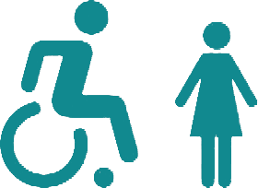
Did You Know?
As of December 2018, 3.1 million dependents of retired workers were receiving 2.3 billion dollars in Social Security benefits each month.
At the same time, 1.6 million dependents of disabled workers were receiving 616 million dollars in monthly Social Security benefits.
socialsecurity.gov/planners
Notes:
As of December 2018, 3.1 million dependents of retired workers were receiving 2.3 billion dollars in Social Security benefits each month. At the same time, 1.6 million dependents of disabled workers were receiving 616 million dollars in monthly Social Security benefits.
When you are doing your financial planning, please remember that we pay benefits to children whose parents are eligible for Social Security retirement, disability, or survivor benefits. The child (or children) must be unmarried and under age 18, or under age 19 if still in high school. To receive benefits on a parent’s record past that point, the child must be unmarried and have a disability that began prior to age 22.
SSI, on the other hand, only pays benefits to the individual; not to his or her children. SSI will pay benefits to children who are found to be disabled according to the appropriate definition of disability.
You can find more information on our benefit planners page www.ssa.gov/planners. Here you can find planners to help spouses, divorced spouses, children, widows and widowers.
Source: ^OCACT and https://www.ssa.gov/OACT/ProgData/icp.html (December 2018 Report)
Slide updated 2/5/2019

Slide 15
Spousal Benefits
Benefit is 50% of worker’s unreduced benefit but is reduced for early retirement. Does not reduce payment to the worker
If spouse’s own benefit is less than 50% of the worker’s, the benefits are combined
No reduction if spouse is caring for a child under age 16 or disabled
Notes:
A spouse who has not worked or who has low earnings can be entitled to as much as one-half of the retired worker’s full benefit.
If you are eligible for both your own retirement benefits and for benefits as a spouse, we always pay your own benefits first. If your benefits as a spouse are higher than your retirement benefits, you will get a combination of benefits equaling the higher spouse benefit.
If spouses want to get Social Security retirement benefits before they reach full retirement age, the amount of the benefit is reduced. The amount of reduction depends on when the person reaches full retirement age.
However, if a spouse is caring for a child under age 16 or disabled, who gets Social Security benefits on the worker’s record, the spouse gets full benefits, regardless of age.
This next slide gives you an example.
https://www.ssa.gov/planners/retire/yourspouse.html

Slide 16
Year of Birth | Full Retirement Age | A $1000 retirement benefit taken at age 62 would be reduced by | A $500 spouse benefit taken at age 62 would be reduced by
1943-1954 | 66 | 25% | 30%
1955 | 66 and 2 months | 25.83% | 30.83%
1956 | 66 and 4 months | 26.67% | 31.67%
1957 | 66 and 6 months | 27.5% | 32.5%
1958 | 66 and 8 months | 28.33% | 33.33%
1959 | 66 and 10 months | 29.17% | 34.17%
1960 + | 67 | 30% | 35%
Notes:
This chart gives an example of how much a $1,000 retirement benefit and a $500 retirement benefit would be reduced if someone took the benefit at age 62.
The increase in full retirement age was the result of the 1983 Amendments to the Social Security Act. Full retirement age increases apply to both Retirement Benefits and Survivors Benefits. Although we at Social Security have always used the term “full” retirement age, you may find that some people now refer to “full retirement age” as the “Normal Retirement Age”. Regardless of your full retirement age, reduced benefits can still be paid as early as age 62.
In addition, the Medicare eligibility age of 65 has not changed. We recommend that you apply for Medicare 3 months before your 65th birthday (unless you are already receiving Social Security benefits when you turn 65, in which case you will be automatically enrolled in Medicare).
Source: https://www.ssa.gov/oact/quickcalc/earlyretire.html

Slide 17
Working While Receiving Benefits
If you are | You can make up to | If you earn more, some benefits will be withheld
Under Full Retirement Age | $17,640/yr. | $1 for every $2
The Year Full Retirement Age is Reached | $46,920/yr. before month of full retirement age | $1 for every $3
Month of Full Retirement Age and Above | No Limit | No Limit
Note: If some of your retirement benefits are withheld because of your earnings, your benefits will be increased starting at your full retirement age to take into account those months in which benefits were withheld.
Notes:
The first thing we recommend is that you visit SocialSecurity.gov/pubs and search for the publication entitled, How Work Affects Your Benefits. It explains the rules you must follow in order to avoid an overpayment, and it gives some great examples for different scenarios that could apply to your individual situation.
You can get Social Security retirement or survivors benefits and work at the same time. However, if you’re younger than full retirement age, and earn more than certain amounts, your monthly benefit remains the same but the total amount of benefits you receive for the year will be reduced. The amount that your annual benefits are reduced, however, isn’t truly lost. Your monthly benefit will be increased at your full retirement age to account for benefits withheld due to earlier earnings.
Note that spouses and survivors, who receive benefits because they have minor or disabled children in their care, don’t receive increased benefits at full retirement age if benefits were withheld because of work. I should also mention that different rules apply if you work outside the United States. Contact us if you’re working (or plan to work) outside the country.
But for most of you, here’s how this works. If you work, and are full retirement age or older, you may keep all of your benefits, no matter how much you earn.
If you’re younger than full retirement age, there is a limit to how much you can earn and still receive full Social Security benefits. If you’re younger than full retirement age, we must deduct $1 from your benefits for each $2 you earn above the annual limit. For 2019, that limit is $17,640.
If you reach full retirement age during 2019, we must deduct $1 from your benefits for each $3 you earn above $46,920 until the month you reach full retirement age.
Starting with the month you reach full retirement age, there is no limit on how much you can earn and still receive all of your Social Security benefits.
Source: https://www.ssa.gov/pubs/EN-05-10069.pdf
Slide updated 2/6/2019

Slide 18
For People Younger Than Full Retirement Age During 2019
If your monthly Social Security Benefit is | And you earn | You’ll receive yearly benefits of
$700 | $17,640 or less | $8,400
$700 | $18,000 | $8,220
$700 | $20,000 | $7,220
Note: Chart above for illustrative purposes only
Notes:
This table provides you with some quick examples to demonstrate how much someone could receive in Social Security benefits for the year 2019, based on his or her monthly benefits and estimated earnings.
In this example, we have a person whose monthly retirement, spousal, or survivor benefit is $700. NOTE: the $700 benefit seems a bit low for an average benefit but it is just an illustrative example. There are definitely people receiving benefits at that $700 level.
In the first row, you see that as long as the person doesn’t earn more than the 2019 limit of $17,640 all benefits are paid for the year ($700 x 12 = $8,400).
In the second row, the person earns a little more than the limit. We take the earned amount, the $18,000, and subtract the limit of $17,640, which leaves $360. Since the offset is $1 in withholdings for every $2 over the limit, we divide $360 in half, leaving $180 to be withheld before he or she is paid Social Security. $180 is the amount that Social Security must withhold up front before the person receives any Social Security payments in 2019. The yearly benefit amount would then be $8,220, or $8,400 minus $180.
In the third row, the person earns $20,000 in gross wages and/or net profit from self employment (which is all that we consider when applying the earnings limit). $20,000 minus the limit of $17,640 means the person went over by $2,360. Since the offset is $1 in withholdings for every $2 over the limit, we divide $2,360 in half, leaving $1,180 to be withheld before he or she is paid Social Security in 2019. $8,400 minus $1,180 equals $7,220 in yearly benefits for this individual, even though the person earned more than $2,000 over the Social Security earnings limit!
So, as you can see, you CAN work and still get some Social Security benefits prior to your full retirement age. And remember that once you reach full retirement age, all of this goes away. You can earn as much as you desire without any worries about a Social Security earnings limit, once you reach full retirement age. But keep in mind that, as we mentioned earlier, the IRS may still apply taxes to your Social Security benefits.
We do realize that sometimes people who retire in mid-year already have earned more than the annual earnings limit. That’s why there is a special rule that applies to earnings for one year, usually the first year of retirement. Under this rule, you can get a full Social Security check for any whole month you’re retired, regardless of your yearly earnings. In 2019, a person younger than full retirement age for the entire year is considered retired if monthly earnings are $1,470 or less.
Source: ^OISP
Slide updated 2/6/2019

Slide 19
Survivor Benefits
When you pass away, your surviving spouse may:
  Claim survivor benefits at any age between 60 and full retirement age.
  At age 60, receive 71.5% of your full benefit and increases each month you wait up to 100% if you start at full retirement age; or
  At full retirement age, receive 100% of deceased worker's unreduced benefit
Notes:
Next, let’s talk about how survivor benefits are calculated.
So, it is possible to get a reduced survivor benefit on one record at age 60, then apply for a reduced – or unreduced – retirement benefit on the other record at age 62 or older.
Full benefits can be paid by Social Security to both the widow or widower and a divorced widow or widower. In other words, benefits paid to a surviving divorced spouse who is 60 or older (age 50 if disabled) will not affect the benefit rates for other survivors receiving benefits.

Slide 20
Auxiliary Benefits for Children
A child must have:
  A parent who’s disabled or retired and entitled to Social Security benefits; or
  A parent who died after having worked long enough in a job where they paid Social Security taxes.
The child must also be:
Unmarried;
Younger than age 18;
18-19 years old and a full-time student (no higher than grade 12); or
18 or older and disabled. (The disability must have started before age 22.)
Notes:
Your child can get benefits if they’re your biological child, adopted child, or dependent stepchild. (Sometimes, your child could also be eligible for benefits on their grandparents’ earnings.)
Within a family, a child can receive up to half of the parent’s full retirement or disability benefit. If a child receives survivors benefits, they can get up to 75 percent of the deceased parent’s basic Social Security benefit. There is a limit, however, to the amount of money that we can pay to a family. The family maximum payment is determined as part of every Social Security benefit computation. It can be from 150 to 180 percent of the parent’s full benefit amount. If the total amount payable to all family members exceeds this limit, we reduce each person’s benefit proportionately (except the parent’s) until the total equals the maximum allowable amount.
Publication: https://www.ssa.gov/pubs/EN-05-10085.pdf

Slide 21
Spouse (living) benefits
Survivor (death) benefits
Can start from age 62 to Full Retirement Age (FRA)
50% at FRA or less if you start prior to FRA (reduction for each month you take it early)
Divorced spouses qualify if marriage lasted at least 10 years and other conditions are met
Can start from age 60 to Full Retirement Age (FRA)
71.5% at age 60 and increases each month you wait, up to 100% if you start at FRA, or as early as age 50 if disabled
Divorced spouses qualify if marriage lasted at least 10 years and other conditions are met
Notes:
Here is a side-by-side comparison of spousal and survivor benefits.
The worker and his or her spouse must be married for one year (continuously) immediately before the day on which the application is filed.
(Note: The one-year requirement can be waived if the spouse is the natural mother or father of the worker’s biological child or if the spouse was entitled or potentially entitled to certain auxiliary or survivor’s benefits in the month before the month of marriage to the worker).
If a spouse is caring for a child under age 16 of the worker, the spouse could qualify regardless of age. When the youngest child turns 16, the spouse’s benefit will stop, even though the child’s benefit will continue. However, if the child is disabled, the spouse’s benefits will continue as long as the child is under his or her care.

Slide 22
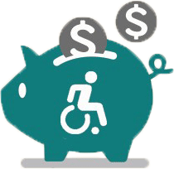
Disability Benefit Statistics
    As of December 2018, Social Security paid an average monthly disability benefit of $1,096.99 That’s barely enough to keep a beneficiary above the poverty guidelines ($12,490 annually).
    According to the U.S. Census Bureau, 56.7 million people living in the United States - 19% of the population - live with a disability.
    38.3 million people - 13% of the population - live with a severe disability.
Notes:
Stats:
Social Security disability payments are modest. As of December 2018, Social Security paid an average monthly disability benefit of $1,096.99. That is barely enough to keep a beneficiary above the poverty guidelines ($12,490 annually, as of January 2019).
- According to the U.S. Census Bureau, 56.7 million people living in the United States - 19% of the population - live with a disability (as of 2010 – most current stats.)
- 38.3 million people - 13% of the population - live with a severe disability.
https://www.ssa.gov/policy/docs/quickfacts/stat_snapshot/index.html?qs (Table 2)
https://aspe.hhs.gov/poverty-guidelines
https://www2.census.gov/library/publications/2012/demo/p70-131.pdf (Table 1)
Source: ^Statistics
Slide updated 1/15/2019

Slide 23
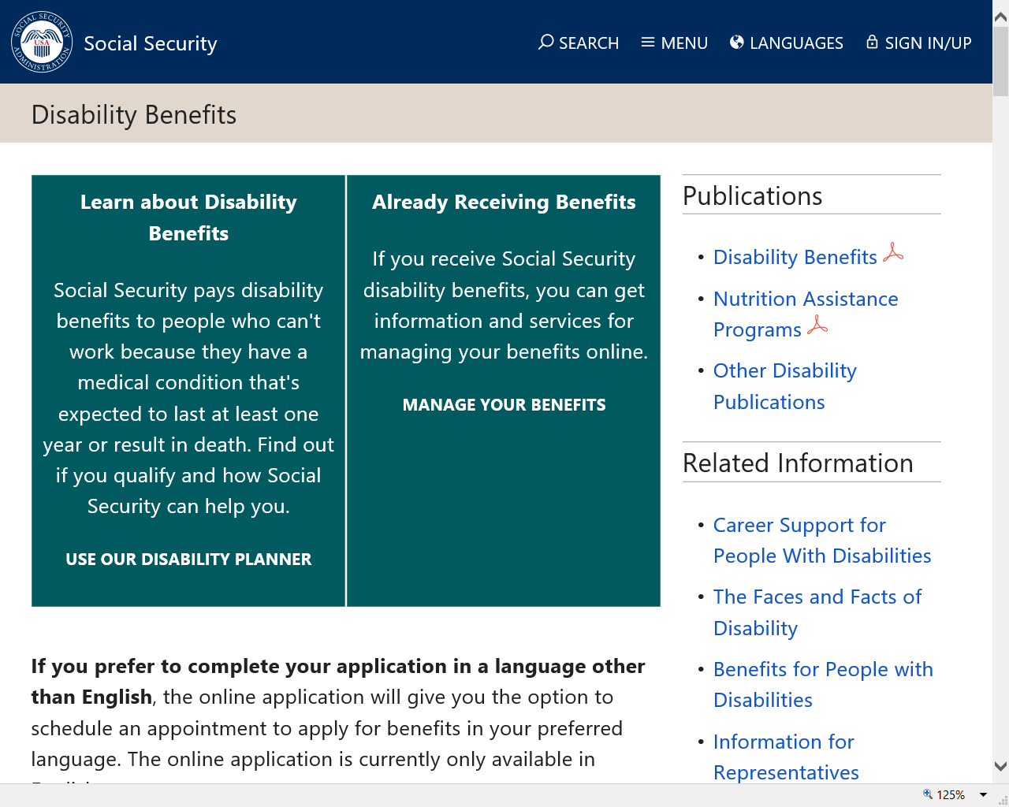

Slide 24
Social Security Disability Insurance (SSDI)
People who are no longer able to perform substantial work activity may qualify if they:
have a medical condition that’s expected to last at least one year or result in death,
are younger than full retirement age (FRA) and earn less than the substantial gainful activity (SGA) limit,
are blind and at least age 55 for certain individuals, and
have earned a certain number of work credits.
Notes:
Social Security’s disability definition is based on your medical condition and the fact that you are not expected to be able to do any work for at least 12 months or your condition is terminal. This work determination is based on your age, education and work experience.
The actual disability definition makes the clear distinction between Social Security’s disability requirements compared to other disability programs, such as Veterans and Workman’s Compensation.
After becoming eligible for a disability benefit, the law requires us to conduct a medical review to ensure that the beneficiary still qualifies for the program. This generally occurs every 3 to 7 years, depending on the severity of the disability.

Slide 25
Work Requirements
Amount of work you need depends age
— 1-1/2 years of work in a three-year
period before becoming disabled
  Age 24-31
  — work during half the time between age
  21 and the time the disability began
  Age 31 or older
  — work during five out of the 10 years before the disability began

Slide 26
Supplemental Security Income (SSI)
A federal program that provides monthly payments to people who have limited income and few resources.
People who are 65 or older, as well as for those of any age, including children, who are blind or who have disabilities.
Notes:
SSI stands for Supplemental Security Income. Social Security administers the SSI program, which pays monthly benefits to adults with limited income and resources who are disabled, blind, or age 65 or older. Blind or disabled children may also get SSI.
People who have worked long enough, recently enough, may be able to receive Social Security benefits – such as disability or retirement – and SSI benefits at the same time, if the amount of Social Security benefits in combination with the person’s other income falls below the SSI income limits.

Slide 27
SSDI vs. SSI
Social Security Disability Insurance | Supplemental Security Income
Payments come from the Social Security trust funds and are based on a person’s earnings. | Payments come from the general treasury fund, NOT the Social Security trust funds. SSI payments are not based on a person’s earnings.
An insurance that workers earn by paying Social Security taxes on their wages. | A needs-based public assistance program that does not require a person to have work history.
Pays benefits to disabled individuals who are unable to work, regardless of their income and resources. | Pays disabled individuals who are unable to work AND have limited income and resources.
Benefits for workers and for adults disabled since childhood. Must meet insured status requirements. | Benefits for children and adults in financial need. Must have limited income and limited resources.
Notes:
When you file an application for disability benefits with Social Security, we always check on your eligibility for both of our programs.
The same medical requirements apply to both programs, but the non-medical requirements differ.
Staff at your local Social Security field office review your non-medical eligibility. If you meet the non-medical requirements for SSDI, SSI, or both programs, we send your claim – or claims – to a medical examiner who works for the state of ___(your state).
Specifically, the medical examiners work for a state agency called the Disability Determination Service, or DDS. Once the medical examiner makes a medical decision on your application, you receive notification by mail, and your local Social Security field office receives notification electronically. If your claim is approved, you start receiving monthly disability benefits. If denied, you have 60 days to file an appeal.
For SSDI, you must have recent work history in order to receive benefits. Adults must have worked and earned Social Security credits in 5 out of the 10 years prior to the onset of the disability.
For younger workers, however, less work is required. For example:
Before age 24:
1 ½ years of work in a three-year period before becoming disabled
Age 24-31:
work during half the time between age 21 and the time the disability began
Age 31 or older:
work during five out of the 10 years before the disability began
However, since you do not need to work and gain insured status for SSI, babies and older people who have never worked can receive SSI benefits. They just need to be blind, disabled, or age 65 or older and have limited income and resources.
Social Security has a specific set of rules that apply to disability beneficiaries. If you receive Social Security disability benefits or Supplemental Security Income payments, you must report all earnings to Social Security.

Slide 28
Disability Evaluation Under Social Security
Also known as “The Social Security Blue Book”
  Provides physicians and other health professionals with an understanding of the disability programs
  Provides information to help health professionals make sound and prompt determinations and decisions on disability claims
  Lists specific criteria under which disabled claimants can qualify for Social Security disability benefits.
socialsecurity.gov/disability/professionals/bluebook
Notes:
Disability Evaluation under Social Security has been specially prepared to provide physicians and other health professionals with an understanding of the disability programs administered by the Social Security Administration. It explains how each program works, and the kinds of information a health professional can furnish to help ensure sound and prompt determinations and decisions on disability claims. The Listing of Impairments, which includes listings for both adults and children, appear in the Code of Federal Regulations (CFR) in appendix 1 to subpart P of part 404 . We also provide them at SocialSecurity.gov/disability/professionals/bluebook. The listings are just part of how we decide if someone is disabled. For adults, we also consider past work experience, severity of medical conditions, age, education, and work skills. We no longer publish Disability Evaluation Under Social Security in hardcopy because we publish updated versions of the Listing of Impairments electronically.
Most Social Security disability claims are initially processed through a network of local Social Security Administration (SSA) field offices and State agencies (usually called Disability Determination Services or DDSs). Subsequent appeals of unfavorable determinations may be decided in a DDS or by an administrative law judge in SSA’s Office of Disability Adjudication and Review.
Social Security representatives in the field offices usually obtain applications for disability benefits in person, by telephone, by mail, or by filing online. The application and related forms ask for a description of the claimant’s impairment (s), treatment sources, and other information that relates to the alleged disability. (The "claimant" is the person who is requesting disability benefits.) The field office is responsible for verifying non-medical eligibility requirements, which may include age, employment, marital status, or Social Security coverage information. The field office then sends the case to a DDS for evaluation of disability.
The DDSs, which are fully funded by the Federal Government, are State agencies responsible for developing medical evidence and rendering the initial determination on whether or not a claimant is disabled or blind under the law.
Usually, the DDS tries to obtain evidence from the claimant's own medical sources first. If that evidence is unavailable or insufficient to make a determination, the DDS will arrange for a consultative examination (CE) to obtain the additional information needed. The claimant's treating source is the preferred source for the CE, but the DDS may obtain the CE from an independent source. After completing its development of the evidence, trained staff at the DDS makes the initial disability determination. Then, the DDS returns the case to the field office for appropriate action. If the DDS found that the claimant is disabled, SSA completes any outstanding non-disability development, computes the benefit amount, and begins paying benefits. If the claimant was found not to be disabled, the file is kept in the field office in case the claimant decides to appeal the determination.

Slide 29
Adult Disability Standard
SSDI SSI
SAME STRICT
ADULT DISABILITY STANDARD
(exception – SSI statutorily blind)

Slide 30
SSI Benefits for Children
Supplemental Security Income (SSI) pays benefits to disabled children living in households with limited
income and resources
For eligibility, we look at the income and assets of parent(s) living in the household and those of the child who is disabled

Slide 31
Compassionate Allowances (CAL)
A way of quickly identifying diseases and other medical conditions that invariably qualify under the Listing of Impairments based on minimal objective medical information
Allows Social Security to target the most obviously disabled individuals for allowances based on objective medical information that we can obtain quickly
Is not a separate program from the Social Security Disability Insurance or Supplemental Security Income programs
socialsecurity.gov/compassionateallowances
Notes:
At Social Security, we have a special program called “Compassionate Allowances” which can get you a much faster, or “expedited,” medical decision if you are diagnosed with specific conditions.
These conditions are selected using information received at public outreach hearings, comments received from the Social Security and DDS communities, counsel of medical and scientific experts, and our research with the National Institutes of Health, or NIH.
In fact, there are more than 225 conditions that qualify for expedited disability claim processing through this program!
To learn more and see if you or someone you know qualifies for this program, visit:
https://socialsecurity.gov/compassionateallowances

Slide 32
Disagree With The Medical Decision?
If you recently applied for Social Security or Supplemental Security Income disability benefits and were denied for medical reasons, you have the right to file an appeal within 60 days of the date on your decision notice.
Notes:
https://www.ssa.gov/benefits/disability/appeal.html

Slide 33
The Red Book – “A Guide to Work Incentives”
The Social Security Disability Insurance (SSDI) and Supplemental Security Income (SSI) programs include a number of employment support provisions commonly referred to as work incentives.
The Red Book is a general reference tool, updated yearly, designed to provide a working knowledge of these provisions.
For educators, advocates, rehabilitation professionals, and counselors who serve persons with disabilities.
socialsecurity.gov/redbook
Notes:
One of the Social Security Administration’s (SSA) highest priorities is to support the efforts of disabled beneficiaries who want to work by developing policies and services to help them reach their employment goals. Our employment-support provisions are intended to assist you in your efforts to become self-sufficient through work. Employment supports can help you find a job or start a business, protect your cash and medical benefits while you work, or save money to go to school. If your benefits end because of your work and you have to stop working later, employment supports can make it easy to begin receiving benefits again. The Social Security Disability Insurance (SSDI) and Supplemental Security Income (SSI) programs include a number of employment support provisions commonly referred to as work incentives.
The Red Book, which can be found on our website, serves as a general reference source about the employment-related provisions of Social Security Disability Insurance and the Supplemental Security Income Programs for educators, advocates, rehabilitation professionals, and counselors who serve people with disabilities. Although you may use the Red Book as a self-help guide, please remember that if you need information specific to your situation regarding eligibility or benefits, you may need to contact us.
We also have further information on our website about working while disabled. Just visit socialsecurity.gov/pubs and search for Working While Disabled: How We Can Help. It explains how we can help you transition back to work if your health condition improves.

Slide 34
What’s New in 2019?
The Substantial Gainful Activity (SGA) amount for individuals with disabilities, other than blindness, increased from $1,180 to $1,220.
The SGA amount for individuals who are blind increased from $1,970 to $2,040 for 2019.
The monthly earnings amount that we use to determine if a month counts for the Trial Work Period month is $880 per month in 2019.
The Supplemental Security Income (SSI) Federal Benefit Rate (FBR) is $771 per month for an eligible individual and $1,157 per month for an eligible couple.
Notes:
There are several important adjustments to the work incentive programs that went into effect January 1, 2019.
Details about these changes can be found in the Red Book.
The Substantial Gainful Activity (SGA) amount for individuals with disabilities, other than blindness, increased from $1,180 to $1,220.
The SGA amount for individuals who are blind increased from $1,970 to $2,040 for 2019.
The monthly earnings amount that we use to determine if a month counts for the Trial Work Period month is $880 per month in 2019.
The Supplemental Security Income (SSI) Federal Benefit Rate (FBR) is $771 per month for an eligible individual and $1,157 per month for an eligible couple.
Source: https://www.ssa.gov/redbook/newfor2019.htm
Slide updated 2/5/2019

Slide 35
What’s New in 2019?
The amount of earnings that will have no effect on eligibility or benefits for SSI beneficiaries who are students is $7,550 per year. The amount of earnings that we can exclude each month, until we have excluded the maximum for the year, is $1,870 per month.
The monthly Medicare Part A Hospital Insurance base premium for less than 30 credits is $437.
The Part B Supplemental Medical Insurance monthly base premium is $135.50. Some people with higher incomes will pay a higher amount.
Notes:
The amount of earnings that will have no effect on eligibility or benefits for SSI beneficiaries who are students is $7,550 per year. The amount of earnings that we can exclude each month, until we have excluded the maximum for the year, is $1,870 per month.
The monthly Medicare Part A Hospital Insurance base premium for less than 30 credits is $437.
The Part B Supplemental Medical Insurance monthly base premium is $135.50. Some people with higher incomes will pay a higher amount.
Source: https://www.ssa.gov/redbook/newfor2019.htm
Slide updated 2/5/2019

Slide 36
Medicare
Eligibility
Age 65
ALS
Kidney failure
After 24 months of SSDI
Environmental health hazard exposure
Notes:
Option to speaker: Can remove ‘environmental health hazard exposure’
Remember that although the full retirement age has increased above age 65, Medicare eligibility is still age 65. One of the most important things to remember is that you can apply for Medicare online, even if you are waiting past age 65 to apply for Social Security retirement benefits.
You should apply for Medicare 3 months before your 65th birthday, even when you plan to apply for your retirement or spouse’s benefits later.
If you are approved for Social Security disability benefits, you will be eligible for Medicare benefits 24 months from the month you were entitled to receive benefits, not from the first month you receive a payment.
If you are diagnosed with Amyotrophic Lateral Sclerosis (Lou Gehrig’s disease) and you get disability benefits, you can get Medicare right away.
If you have permanent kidney failure and you receive maintenance dialysis or a kidney transplant – you may also be eligible for Medicare.
*Note to speaker: If an audience member asks about Medicare based on exposure to environmental health hazard,
provide this link: www.ssa.gov/OP_Home/ssact/title18/1881A.htm

Slide 37
Medicare
Enrollment
Initial Enrollment Period
Begins 3 months before your 65th birthday and ends 3 months after that birthday
Special Enrollment Period
If 65 or older and covered under a group health plan based on your – or your spouse’s – current work.
General Enrollment Period
January 1 – March 31
Notes:
Medicare has three enrollment periods:
Initial Enrollment Period-- your initial enrollment period has a 7-month enrollment period. It begins three months before your 65th birthday, includes the month you turn age 65, and ends three months after that birthday.
Special Enrollment Period-- If you are age 65 or older, you or your spouse are still working and you are covered under a group health plan based on that current employment, you may not need to apply for Medicare medical insurance (Part B) at age 65. You may qualify for a "Special Enrollment Period" (SEP) that will let you sign up for Part B a the time you retire.
General Enrollment Period - If you didn't sign up for Part A and/or Part B (for which you must pay premiums) when you were first eligible, and you aren’t eligible for a Special Enrollment Period, you can sign up during the General Enrollment Period between January 1–March 31 each year. You may have to pay a late enrollment penalty for as long as you have Part B coverage.

Slide 38
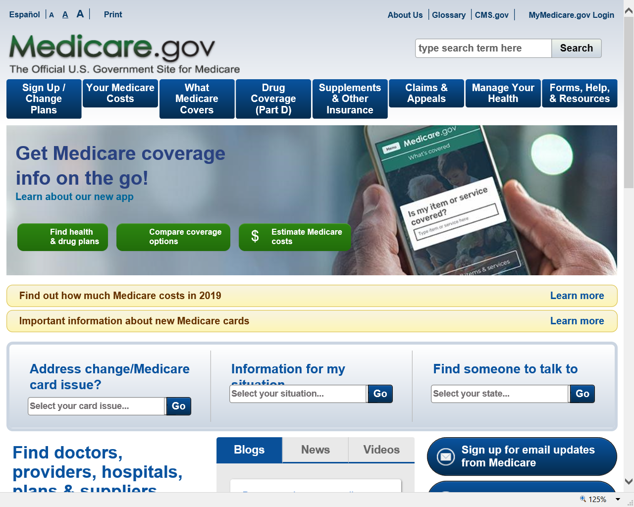

Slide 39
Medicare Part B Coverage
If you enroll in this month of your initial enrollment period: | Then your Part B Medicare coverage starts:
One to three months before you reach age 65 | The month you reach age 65
The month you reach age 65 | One month after the month you reach age 65
One month after you reach age 65 | Two months after the month of enrollment
Two or three months after you reach age 65 | Three months after the month of enrollment
Notes:
This chart shows when your Medicare will become effective if you apply during your initial enrollment period.
If you apply during the 3-month window prior to the month you turn age 65, your Medicare kicks in the 1st day of the month you reach age 65.

Slide 40
Medicare standard Part B premium for 2019
If you’re single and file an individual tax return, or married and file a joint tax return:
Modified Adjusted Gross Income (MAGI) | Part B monthly premium amount | Prescription drug coverage monthly premium amount
Individuals with a MAGI of $85,000 or less Married couples with a MAGI of $170,000 or less | 2019 standard premium $135.50 | Your plan premium
Individuals with a MAGI above $85,000 up to $107,000 Married couples with a MAGI above $170,000 up to $214,000 | Standard premium + $54.10 | Your plan premium + $12.40
Individuals with a MAGI above $107,000 up to $133,500 Married couples with a MAGI above $214,000 up to $267,000 | Standard premium + $135.40 | Your plan premium + $31.90
Individuals with a MAGI above $133,500 up to $160,000 Married couples with a MAGI above $267,000 up to $320,000 | Standard premium + $216.70 | Your plan premium + $51.40
Individuals with a MAGI above $160,000 up to $500,000 Married couples with a MAGI above $320,000 up to $750,000 | Standard premium + $297.90 | Your plan premium + $70.90
Individuals with a MAGI equal to or greater than $500,000 Married couples with a MAGI equal to or greater than $750,000 | Standard premium +$325.00 | Your plan premium + $77.40
Notes:
This graphic shows the Medicare premiums for each income bracket.
IRMAA: If you're in a higher-income household, you may be subject to an income-related monthly adjustment amount.
Health Savings Account (HSA) Information: You should not contribute to an HSA if you are enrolled in Medicare as there may be negative tax implications. Contact your tax professional for more information.
----
[SPEAKER: see chart at bottom of this page: https://www.medicare.gov/part-d/costs/premiums/drug-plan-premiums.html for Part D information]
IRMAA resource: https://secure.ssa.gov/poms.nsf/lnx/0601101035
Source: Publication EN-05-10536
Slide updated 01/22/19

Slide 41

Extra Help Program
Medicare beneficiaries may qualify for Extra Help with their Medicare prescription drug plan costs.
Extra Help is estimated to be worth about $4,900 per year.
Find out if you qualify at socialsecurity.gov/extrahelp
Notes:
Extra Help is available for beneficiaries with limited resources and income to help pay for the costs related to a Medicare prescription drug plan. These costs include monthly premiums, annual deductibles and prescription co-payments. Extra Help is estimated to be worth about $4,900 per year.
You may apply for Extra help online, over the phone, or in your local Social Security office, which will review your application and send you a letter to let you know if you qualify. There are 6 main advantages to applying online for Extra Help:
The online application takes you through all of the questions to help you
answer them completely
You can apply from the convenience of any computer, at your own pace
If you have to take a break, you can stop and return to the application later without losing the information you already filled in
If you don’t have or use a computer, someone else like a friend, relative, or caregiver can help you fill out the application
Our online application is safe and secure
It’s generally much faster to apply online. There’s no mail time as there is
with a paper application, so decisions usually can be made more quickly.
Source: ^OISP and www.socialsecurity.gov/extrahelp
Slide updated 1/31/2019

Slide 42
my Social Security Services
If you receive benefits or have Medicare, you can:
  Request a replacement Social Security card if you meet certain requirements;
  Report your wages if you work and receive Disability Insurance (SSDI) and/or Supplemental Security Income (SSI) benefits;
  Get a benefit verification letter
  Check your benefit and payment information and your earnings record;
  Change your address and phone number;
  Start or change direct deposit of your benefit payment;
  Request a replacement Medicare card; and
  Get a replacement SSA-1099 or SSA-1042S for tax season.
Notes:
So what can you do with a my Social Security account? Your online my Social Security account provides a wealth of information to help you and your family plan for your financial future. If you receive benefits or have Medicare, you can:
Request a replacement Social Security card if you meet certain requirements;
Report your wages if you work and receive Disability Insurance (SSDI) and/or Supplemental Security Income (SSI) benefits;
Get a benefit verification letter as proof that you are getting benefits;
Check your benefit and payment information and your earnings record;
Change your address and phone number;
Start or change direct deposit of your benefit payment;
Request a replacement Medicare card; and
Get a replacement SSA-1099 or SSA-1042S for tax season.
Source: https://www.ssa.gov/myaccount/what.html
Slide reviewed 1/4/2019 - current

Slide 43
my Social Security Services
If you do not receive benefits, you can:
  Request a replacement Social Security card if you meet certain requirements;
  Check the status of your application or appeal;
  Get a benefit verification letter Get your Social Security Statement to review:
    Estimates of your future retirement, disability, and survivor benefits;
    Verify the amounts that we posted are correct
Notes:
If you do not receive benefits, you can…
Source: https://www.ssa.gov/myaccount/what.html
Slide reviewed 1/4/2019 - current

Slide 44
Enhanced Security for your
my Social Security Account
We recently added a second method to check the identification of account holders when you register or sign in.
This is in addition to the first layer of security, your username and password.
You will be able to choose either your cell phone or your email address as your second identification method.
Notes:
Social Security continues to evaluate and improve how we protect what’s important to you. We take this responsibility seriously, and we have a robust cybersecurity program in place to help protect the personal information you entrust to us. Adding additional security measures to safeguard your personal information — but making our services easy to use — is a vital part of keeping you safe and secure.
On June 10, 2017, we added a second method to check your identification when you sign in to my Social Security.
This is in addition to the first layer of security, your username and password.
The next time you sign in, you will be able to choose either your cell phone or your email address as your second identification method.
Using two ways to identify you when you log on will help better protect your account from unauthorized use and potential identity fraud.
We’re committed to using the best technologies and standards available to protect our customers’ data. This new security advancement is just one of the ways we’re ensuring the safety of the resources entrusted to us.
In addition to these security enhancements, we are also upgrading the look and feel of my Social Security, in an effort to create an enhanced customer experience. The my Social Security portal will automatically adjust to the size of the screen and kind of device you are using – such as a tablet, smart phone, or computer. No matter what type of device you choose, you will have full, easy-to-use access to your personal my Social Security account.

Slide 45
Enhanced Security for your
my Social Security Account (cont.)
Each time you sign in to your account, you will complete two steps:
• Step 1: Enter your username and password.
• Step 2: Enter the security code we send by text message or email, depending on your choice (cell phone provider text message and data rates may apply).
If a user does not have a text-enabled cell phone, or does not wish to provide their cell phone number, they will need to use their email address as a second identification method instead.

Slide 46
How to Open a my Social Security Account
1
Visit socialsecurity.gov/myaccount
2
Select: “Sign In or Create an Account.”
Provide some personal information to verify your identity.
3
4
Choose a username and password, then select how you would like to receive a one-time security code to create your account.
No matter what type of device you use, the my Social Security portal will automatically re-adjust to fit the appropriate screen size, providing you full,
easy-to-use access to your personal account!
Notes:
To open a my Social Security account, you have to be at least 18 years of age, have a valid e-mail address, a Social Security number, and a U.S. mailing address.
To open your account, go to socialsecurity.gov/myaccount and select “Sign In or Create an Account.”
You will have to provide some personal Social Security information about yourself and give us answers to some questions only you are likely to know to verify your identity.
Next, you choose a “username” and an 8-character “password” to access your online account. This process protects you and keeps your personal Social Security information private.
Remember to choose email or text under “Message Center Preferences” to receive courtesy notifications about your account.
You will also notice the option of adding an extra level of security to your account. By selecting “Yes, let’s start now” you are prompted to select an additional question to answer. With this feature, you will receive a temporary code via text message each time you attempt to log in. And you will use this code with your account password. Keep in mind that your cell phone provider’s message rates may apply.

Slide 47
my Social Security
You can assist someone in creating a my Social Security account if they:
are with you;
have their own email address;
can answer the “out of wallet” questions; and
have been appointed a payee.
You cannot create a my Social Security account on behalf of another person by using another person's information or identity, even if you have that person's written permission.
For example, you cannot create an account for another person:
with whom you have a business relationship;
for whom you are a representative payee; or
for whom you are an appointed representative.

Slide 48
my Social Security
You can visit your local field office to obtain a unique activation code.
You will need to bring in proof of identity in one of the following forms (must be current):
State driver's license or identity card;
U.S. passport or passport card;
U.S. military identification; or
U.S. government employee identification card.
Notes:
Reasons they have to go into the office --- block on credit report, can’t get through initial screen (recent address change), NUMI discrepancy, etc.

Slide 49
Social Security:
With You Through Life’s Journey…
Produced at U.S. taxpayer expense
Notes:
Notes to speaker:
DO NOT remove the taxpayer expense disclaimer from this slide, as it is now required by law.
Be sure to thank the person who invited you to speak, thank the organization for making SSA a part of today’s event.
JP-2/7/2019

